Slide 1
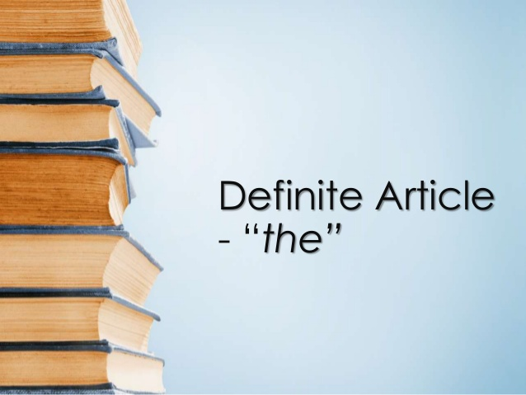


Definite Article
“The”

Slide 2
Use the to refer to something which has already been mentioned.
On Monday, an unarmed man stole $1,000 from the bank. The thief hasn't been caught yet.
I was walking past Benny's Bakery when I decided to go into the bakery to get some bread.
Use the in sentences or clauses where you define or identify a particular person or object.
The man who wrote this book is famous.
I scratched the red car parked outside.
I live in the small house with a blue door.
To people or objects that are unique.
The sun rose at 6:17 this morning.
You can go anywhere in the world.
Clouds drifted across the sky.
The president will be speaking on TV tonight

Slide 3
Use the before superlatives and ordinal numbers..
This is the highest building in New York.
You are the tallest person in our class.
This is the third time I have called you today.
With decades
He was born in the seventies.
This is a painting from the 1820's.
With names of geographical areas, rivers, mountain ranges, groups of islands, canals, and oceans.
They are travelling in the Arctic.
Our ship crossed the Atlantic in 7 days.
I will go on a cruise down the Nile.
Hiking across the Rocky Mountains would be difficult.

Slide 4
With countries that have plural names
I have never been to the Netherlands.
Do you know anyone who lives in the Philippines?
Use the with countries that include the words "republic", "kingdom", or "states" in their names.
She is visiting the United States.
The United Kingdom is in Europe.
With the names of famous buildings, works of art, museums, or monuments.
Have you been to the Vietnam Memorial?
We went to the Louvre and saw the Mona Lisa.
I would like to visit the Eiffel Tower.

Slide 5
With the names of hotels & restaurants, unless these are named after a person.
They are staying at the Hilton on 6th street.
We ate at the Golden Lion.
I went to the Denny’s restaurant at Obregon Avenue.
Names of families
We're having dinner with the Smiths tonight.
The Browns are going to the play with us.

Slide 6
Do not use “The” with…
Holidays
With the names of languages.
With the names of meals.
Christmas is my favorite holiday of the year.
English is a very easy language to learn.
Lunch is my favorite meal.
I like to eat breakfast early.

Slide 7
Do not use “The” with…
Noun + Number
Titles when combined with names.
Subjects
My English class is in room 6
Prince Charles is Queen Elizabeth's son.
President Kennedy was assassinated in Dallas.
Math is so complicated to understand sometimes.
My favorite class is biology.

Slide 8
Do not use “The” with…
Names of shops
Years
Uncountable Nouns
Let’s go to Walmart to get what we need for dinner.
You should get him a gift card from Game Stop
2020 was a year that marked everyone’s life.
I was born in 1995.
Rice is an important food in Asia.
Milk is often added to tea in England.
War is destructive.

Slide 9
Do not use “The” with…
The names of individual mountains, lakes and islands
Most names of towns, streets, stations and airports
Sports
Mount McKinley is the highest mountain in Alaska.
She lives near Lake Windermere.
Have you visited Long Island?
Victoria Station is in the center of London.
Can you tell me how to get to Nuevo Leon Avenue?
She lives in Florence.
I wish I learn how to play basketball someday.
What do you like more, football or soccer?

Slide 10
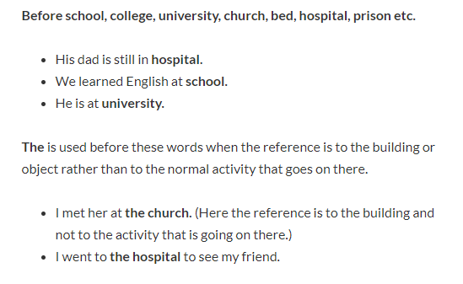

Slide 11
Sources
https://www.ef.com/ca/english-resources/english-grammar/definite-article/#:~:text=The%20word%20%22the%22%20is%20one,of%20which%20are%20listed%20below.
https://avi.cuaed.unam.mx/repositorio/moodle/pluginfile.php/2360/mod_resource/content/16/contenido/index.html
https://www.youtube.com/watch?v=uU-RbEEolw0 (video)

